Slide 1


Virtual Assistant
for mute people
DEPARTMENT OF COMPUTER SCIENCE ST. XAVIER'S (AUTONOMOUS) COLLEGE
PROJECT MENTOR Prof. Shalabh Agarwal
TEAM MEMBERS
Aditya Vikram Sharma 517
Mounav Bhattacharya 550
Ashish Lal 556

Slide 2



INDEX
7.REASONS FOR CHOOSING EVOLUTIONARY MODEL
1.INTRODUCTION
2.PURPOSE
8.SYSTEM ARCHITECTURE
3.SCOPE OF THE SYSTEM
9.DATAFLOW DIAGRAM
4.CURRENT SYSTEMS
10.SYSTEM WORKFLOW
5.PROPOSED SYSTEMS
11.MARKET POTENTIAL AND FUTURE SCOPE
6.SOFTWARE MODEL

Slide 3

INTRODUCTION
Virtual assistant devices such as Amazon Echo or Google Home Mini are designed for use in households or workplaces. They can perform a wide range of tasks, such as playing music, providing answers to inquiries, managing to-do lists, and setting timers or alarms. To operate an Echo device the end user must use a set of ”wake words” to trigger the device and then input a spoken command for it to perform the desired task.
However digital assistants such as Siri or Amazon’s Alexa are largely ineffective in the Mute community because they heavily rely on auditory input and feedback from the end user.

Slide 4

PURPOSE
Our purpose is to develop a virtual assistant specially tailored for individuals who are mute. This will allow such individuals to communicate using hand sign language. Our real-time model will utilize a webcam to capture the hand signs, convert them into standard text, and then relay this information to the virtual assistant module. This innovative approach will empower mute individuals to engage with technology efficiently, enhancing their communication and overall quality of life.

Slide 5

SCOPE OF THE SYSTEM
Capturing and Tracking hand signs- facilitate real-time hand recognition through webcam input. Identify and segregate distinct hand landmarks. The system also tracks and monitors the detected hands in real-time.
Sign Language Recognition- the virtual assistant will be designed to recognize and interpret various sign languages, allowing mute individuals who use sign language as their primary means of communication to interact with technology
Natural Language Processing- Once the sign language is converted into textual data, it is further refined and converted into appropriate language structures.
Command Recognition and Execution- The refined textual data is translated into actionable commands. The system executes the commands to perform specific tasks like playing music, retrieving information, etc.

Slide 6

Presently, various initiatives and research projects are exploring the development of virtual assistants for individuals who communicate using sign language. These systems aim to interpret sign language gestures and convert them into text or speech
CURRENT
SYSTEMS

Slide 7
Gesture Recognition systems: These systems use computer vision and machine learning algorithms to interpret hand gestures and convert them into corresponding text or spoken words.
Drawbacks:
Accuracy and Reliability:- Gesture recognition systems may face challenges in accurately interpreting and recognizing gestures, introducing potential errors in command execution. The reliability of these systems can be influenced by variations in gesture execution, environmental conditions, or technical limitations.
Limited Gesture Vocabulary:- Some systems may experience limitations due to a constrained set of recognized gestures. This restriction can be a drawback, particularly in applications where a broader range of commands is desirable.

Slide 8
Flex sensors: are implemented to capture the hand gestures of a user. The flex sensors output a stream of data that varies with the degree of bend. A Speaking system is incorporated with flex sensors whose, resistance value changes according to the gestures specified by the user. This gesture information is processed by the ESP32 microcontroller and corresponding voice output is given through the speaker which is connected to the voice module in the desired languages.
Drawbacks:
Limited Range:- Flex sensors are often constrained by a limited range of motion for accurate detection. Beyond this range, the sensor may exhibit reduced reliability and imprecise measurements.
Cost:- The cost of flex sensors can vary depending on the technology and materials used in their construction. In comparison to alternative sensor types, flex sensors may be relatively expensive. This cost factor can impact their adoption, especially in applications where cost-effectiveness is a critical consideration.

Slide 9
Sign Language Translation Applications: Some mobile applications are designed to translate sign language into written or spoken language. Users can interact with these apps using their device's camera.
Drawbacks:
Latency Challenges:- Real-time translation applications may encounter delays, affecting the smooth flow of communication. Ensuring low-latency processing is essential, particularly in dynamic and fast-paced conversations where timing is critical. Addressing latency challenges is crucial for maintaining effective and natural communication.

Slide 10
PROPOSED
SYSTEM

Slide 11
Functional requirements:
Requirement ID: FR001
Description: The virtual assistant will capture and recognize the hand signs of the user in the form of real-time video data.
Acceptance Criteria:
The virtual assistant will have a built-in camera or utilize the device's camera to capture a live video feed of the user's hand gestures.
Distinct hand landmarks will be identified and segregated.
The virtual assistant will provide real-time feedback to the user, confirming the recognized hand sign and initiating the corresponding action or response.
.

Slide 12
Requirement ID: FR002
Description: The virtual assistant will track and monitor the detected hands in real-time. This tracking functionality enhances the system’s
capacity to discern hand gestures effectively.
Acceptance Criteria:
The system employs hand-tracking algorithms for hand detection to identify and isolate the hands within the video feed.
The virtual assistant shall be able to track hand movements adapting to varying distances and angles..
The virtual assistant will include a calibration feature to optimize hand-tracking accuracy for individual users.

Slide 13
Requirement ID: FR003
Description: The virtual assistant will make use of machine learning algorithms to accurately recognize and interpret hand signs used in sign language.
Acceptance Criteria:
The captured hand frames are sent as input to a pre-trained machine-learning model capable of recognizing a predefined set of hand signs commonly used in sign language.
The machine learning model interprets the hand signs and translates them into textual representations.
The model will be trained on a dataset that includes variations in hand shapes, sizes, and orientations to ensure robust recognition across diverse user populations.

Slide 14
Requirement ID: FR004
Description: The virtual assistant will implement natural language processing (NLP) capabilities to further refine the gathered textual data, thus ensuring the interpretability of the system’s output.
Acceptance Criteria:
The textual representations produced as output from the machine learning model are taken as input. Data is further refined and converted into appropriate language structures.
This enhances the accuracy and linguistic coherence of the system.
The NLP system will accurately parse the textual input, taking into account variations in language structure, grammar, and context.

Slide 15
Requirement ID: FR005
Description: The virtual assistant shall be capable of recognizing and executing user commands, allowing users to perform specific actions or tasks through signed instructions.
Acceptance Criteria:
The virtual assistant translates the refined text from the NLP module into actionable commands which are then executed.
The virtual assistant will recognize a predefined set of command phrases or gestures that correspond to specific actions or tasks.
The system will include error-handling mechanisms to address cases where a command is not recognized or if there are issues in executing the command.

Slide 16
NON FUNCTIONAL REQUIREMENTS
1. Usability:
The virtual assistant's user interface will be designed to be intuitive and user-friendly, adhering to accessibility standards to accommodate users with varying degrees of motor skills.
The user interface of the virtual assistant will be designed with a clean layout ensuring ease of navigation.
The system shall provide a user-friendly onboarding process to introduce new users to the virtual assistant's features and functionalities.
The virtual assistant shall offer contextual help and guidance, providing assistance or clarification when users encounter unfamiliar commands or situations.

Slide 17
2. Performance:
The virtual assistant will respond to user inputs within seconds for both recognition and execution of commands to ensure real-time interaction.
The system will optimize resource utilization, ensuring efficient use of CPU and memory to minimize the impact on device performance.
The virtual assistant will have low network latency for sending and receiving data, to provide a responsive user experience.
The virtual assistant will promptly handle errors, providing feedback to users within seconds of encountering an issue to maintain a smooth and transparent user experience.

Slide 18
3. Adaptability:
The virtual assistant will be able to effectively track and recognize hand movements adapting to varying distances and angles.
The system will use adaptive language models to evolve its understanding of language nuances, dialects, and user-specific vocabulary, ensuring accurate interpretation of user queries.
The virtual assistant shall utilize adaptable hand sign recognition models, allowing the system to learn and adapt to variations in users' signing styles over time.

Slide 19
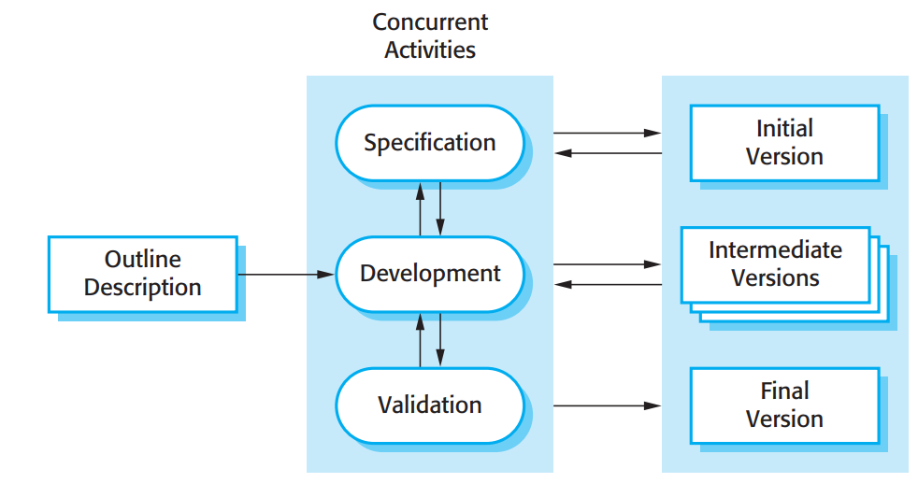
SOFTWARE MODEL
For our specific project, the Evolutionary Model approach was the preferred choice.

Slide 20
REASONS FOR CHOOSING EVOLUTIONARY MODEL
Flexibility and Adaptability
Effective Response to Changes
Early Software Production:
Enhanced Risk Analysis
Support for Changing Environments
Continuous Improvement
Complex Problem Solving
Robustness

Slide 21
SYSTEM ARCHITECTURE
The architecture is divided into three main components: Data Acquisition, Processing and Recognition, and User Interface.
Data Acquisition
This component involves the capture of sign language gestures. It includes hardware such as cameras for gesture detection and a pre-processing module for noise reduction.
Sensors/Cameras: High-resolution cameras capable of capturing fine details of hand gestures.
Pre-processing Module: Removes noise and enhances the quality of captured data. It involves techniques like background subtraction and image normalization.

Slide 22
2. Processing and Recognition
The captured data undergoes several stages of processing, including feature extraction, pattern recognition, and mapping to sign language vocabulary. Machine learning algorithm is employed for recognition.
Feature Extraction: Identifies relevant features from the captured data. This includes hand shape and movement.
Machine Learning Models: Trained models for recognizing patterns in sign language gestures. Deep learning models like Convolutional Neural Networks (CNNs) are suitable.
Sign Language Vocabulary Mapping: A mapping system to convert recognized patterns to corresponding sign language vocabulary.

Slide 23
3. User Interface
The User Interface component involves the presentation of recognized gestures, whether as text. Then this is integrated towards the command execution module.
Output Module: Converts recognized gestures into user-friendly output, such as text, speech synthesis.
Command Execution module: Converts the text into commands and execute those commands.
4. Command execution module
The command execution module then take the text and execute the command as intended.

Slide 24
SYSTEM WORKFLOW
Data Flow
Data Capture: Sensors/cameras capture sign language gestures.
Pre-processing: Raw data is pre-processed to enhance quality.
Feature Extraction: Relevant features are extracted from the pre-processed data.
Recognition: Machine learning models recognize patterns in the features.
Mapping: Recognized patterns are mapped to sign language vocabulary.
Command execution: The command is then executed with required module.
2. Interaction Flow
User Gestures: Users perform sign language gestures in front of the system.
Recognition: The system processes and recognizes the gestures.
Command execution: The recognized gestures is then converted into command and it is then executed.
3. Technologies Used
Programming Languages: Python for machine learning, for the user interface.
Machine Learning Frameworks: TensorFlow, PyTorch for building and training models.
Image Processing Libraries: OpenCV, Mediapipe for pre-processing tasks.
Command Execution: Selenium, Webbrowser,PyAutoGui for command execution

Slide 25
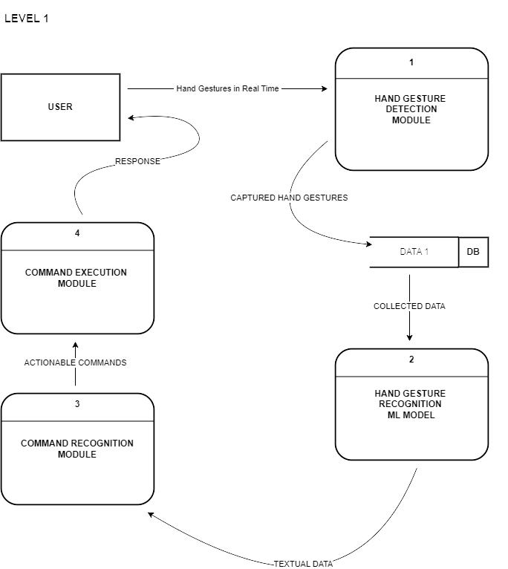
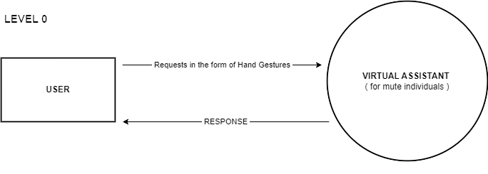
DATA FLOW DIAGRAM

Slide 26
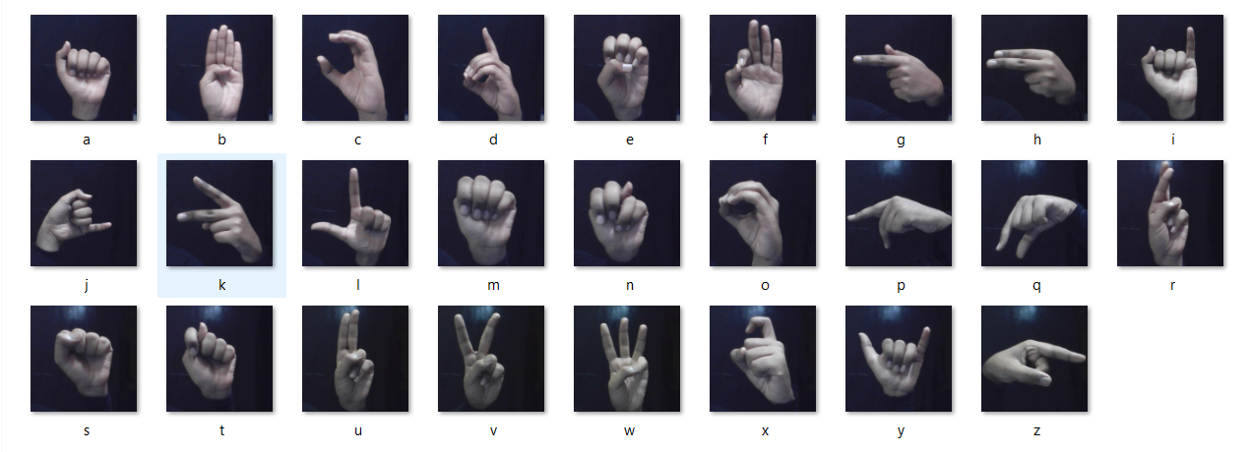
DATASET DESCRIPTION
We have created a custom dataset for our project and it is based on the American Sign Language (ASL).
In American sign language for each of the 26 alphabets, there is a unique hand sign. So the dataset is created by collecting several images of hand gestures for each alphabet/class.
It is a multiclass dataset. In other words, each data point in our dataset can be assigned to one of several categories or classes.
Fig : American Sign Language ( ASL )

Slide 27
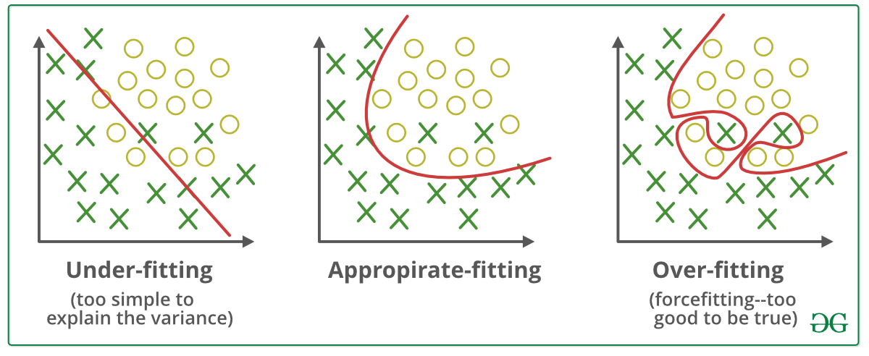
DATASET COLLECTION
We have used the built-in device camera to capture and collect around 300 images of our hands for each class of the data ( for each alphabet ) in different lighting conditions and angles. To perform this task we have used the OpenCV library in Python.
We need to save our dataset by pickling it. Pickling is a process by which we can store our dataset in the form of a binary file
It is imperative to optimize the storage and processing resources by cropping the webcam frame to isolate the region of interest, specifically the hands. Failure to do so not only impacts the accuracy of hand detection but also introduces the risk of overfitting during model training.
Fig : Under-fitting and Over-fitting

Slide 28
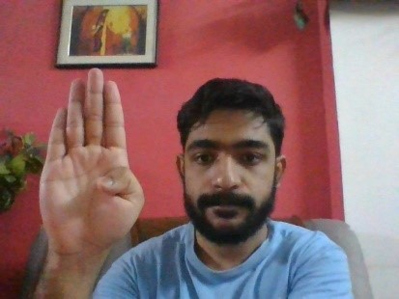
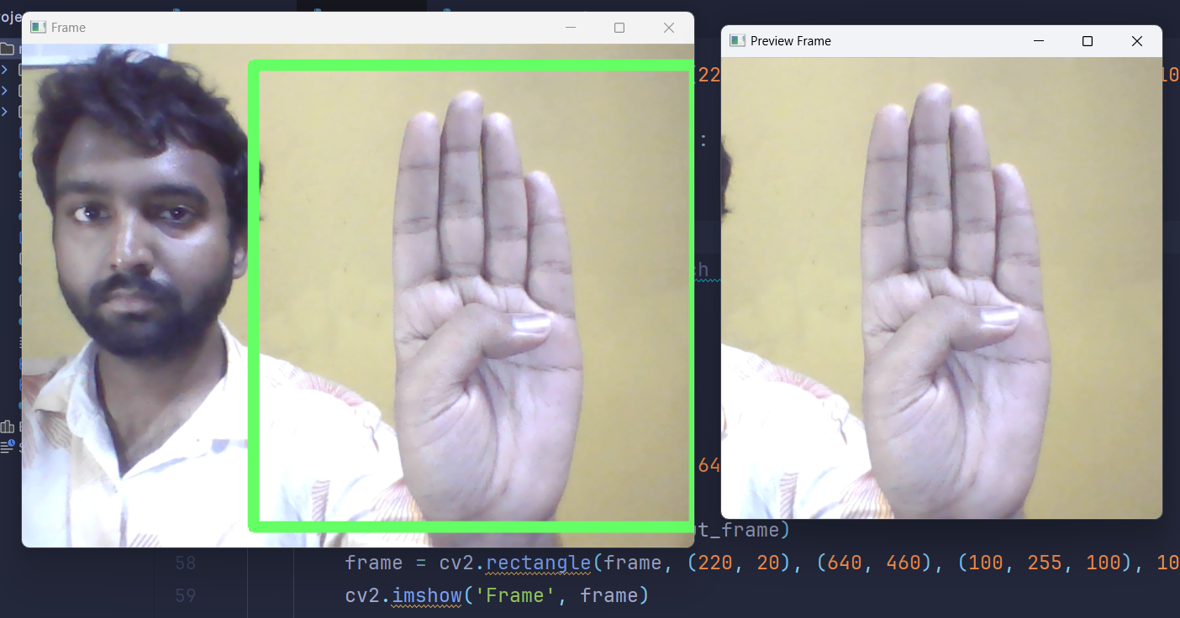
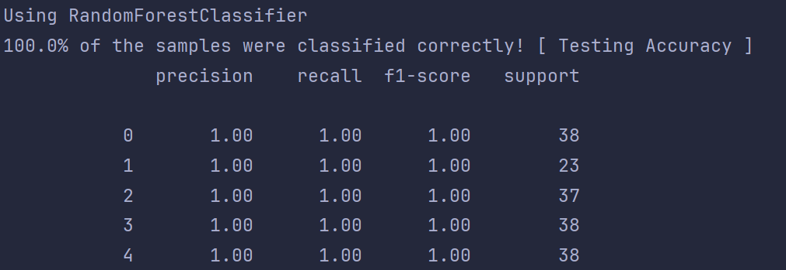
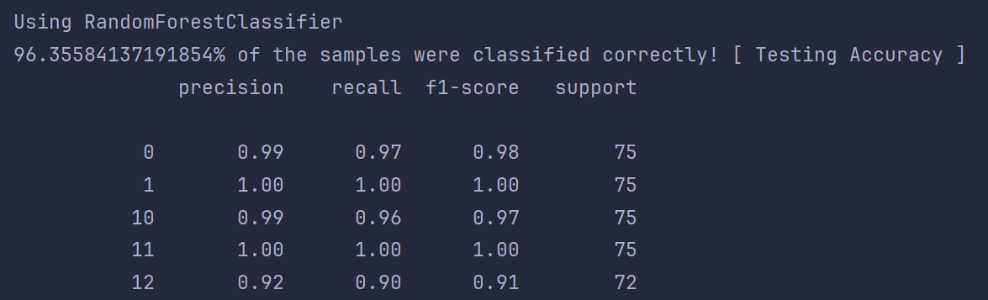
Using entire webcam frame for dataset
ii. Using the cropped image of hand
Fig : How webcam frame while collecting images impacted testing accuracy and solved the over-fitting problem

Slide 29

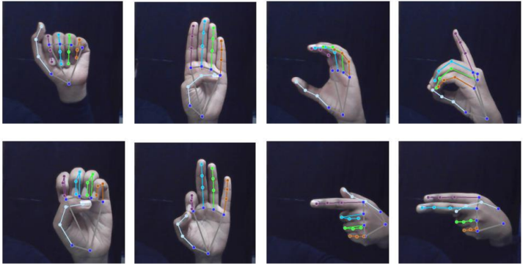
HAND LANDMARKS AND DATASET CREATION​
​
Hand Landmarks indicate the key points of hands such as fingertips, knuckles, finger joints, wrist points, etc. We require the Media Pipe library, specifically the media pipe hands machine learning model for detecting and processing the hand landmarks in our images.
We iterate through all the directories of images and for each image we process and store the hand landmarks. The media pipe hand landmarks model works best with RGB images. So after reading the images using opencv, we need to convert it from BGR to RGB format.
we extract the x and y coordinates of the 21 processed hand landmarks of each image and store them in an auxiliary array. Finally, we store all the auxiliary arrays into one big data array. The subdirectory names make up the respective class labels. makes up our dataset. The data array and the class labels together form our dataset.

Slide 30
MULTICLASS CLASSIFICATION
Our objective is to predict and assign each hand sign to one of the 26 classes without overlapping. We needed a suitable classifier to learn from our data and make highly accurate prediction.
As there are a lot of classifiers, each classifier has its restrictions but there is no such rule that implies a particular classifier is suitable for a particular dataset.
But we needed classifiers more specific to our requirements, a classifier that can perform multiclass and image classification.
Therefore to determine which classifier is best suited for the task, we apply various classifiers to our dataset and calculate the various performance metrics. The classifier with the best performance metric is then chosen.
Classifiers taken into consideration where Random Forest Classifiers, K Nearest Neighbors (KNN) and Decision Trees.

Slide 31
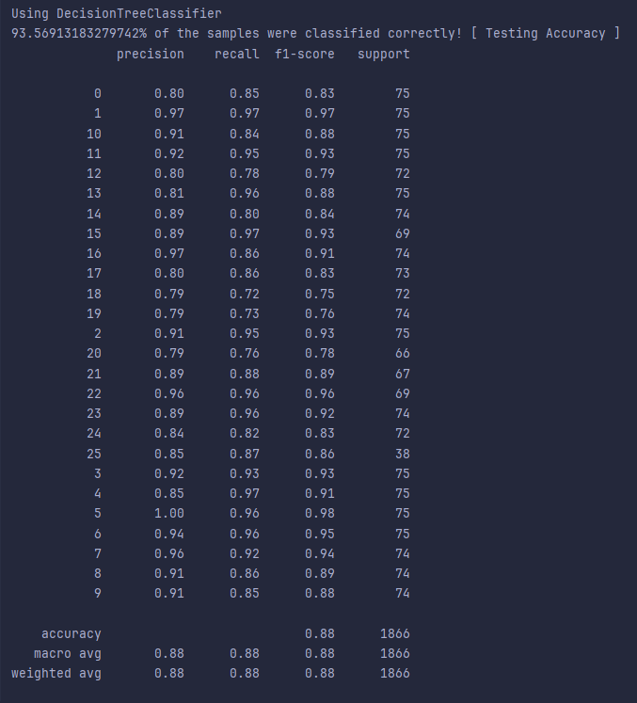
CLASSIFIER PERFORMANCE METRICS
​
Choosing the suitable classifier performance metric is crucial in evaluating different models and approaches.
Some important metrics:
Accuracy/Recognition Rate- It determines how accurately the model is predicting the outcome. However, it is not a good measure if the data samples are unbalanced.
Error/Misclassification Rate- This determines the rate at which the model is incorrectly classifying the data.
Precision- It is a measure of exactness.
Recall- It is a measure of completeness.
F1 score- This metric is the harmonic mean of precision and recall.
After comparing classification report of Random Forest , Decision Tree and K Nearest Neighbor classifiers Random Forest Classifier was selected as it provided better testing accuracy as compared to K Nearest Neighbors and Decision Tree.
Fig : Classification Report of Decision Tree

Slide 32
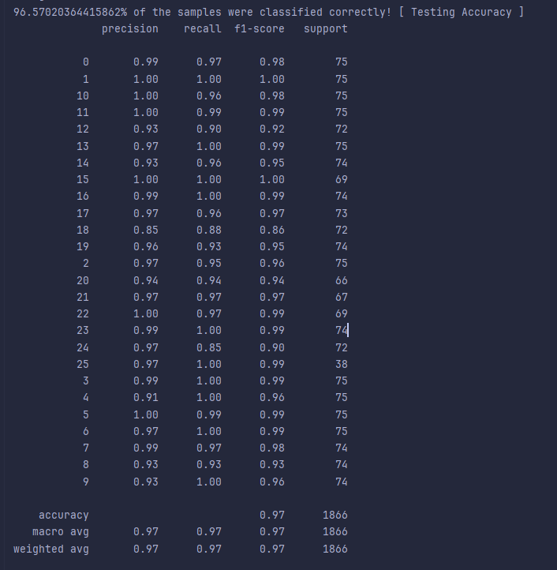
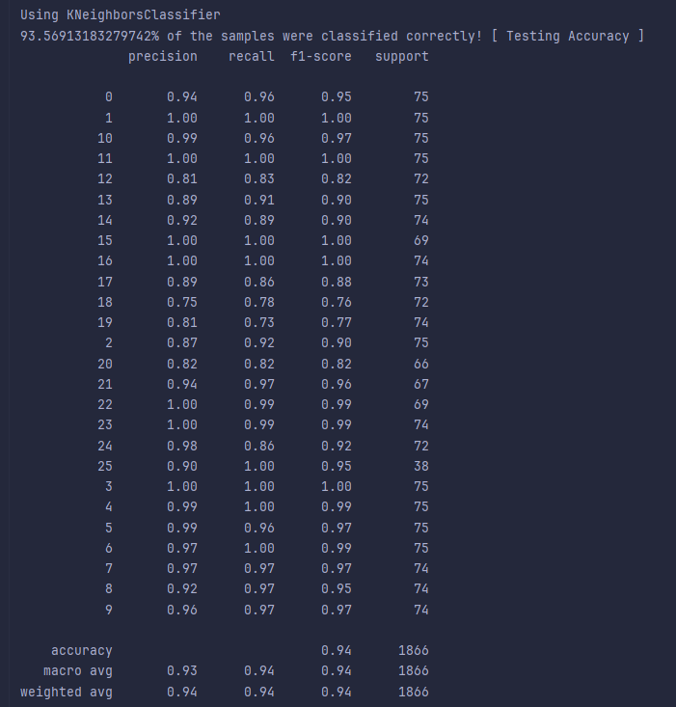
Fig : Classification Report of Random Forest
Fig : Classification Report of KNN

Slide 33
RANDOM FOREST CLASSIFIER
​​
Random forests are ensemble learning methods that build multiple decision trees during training and output the mode of the classes (classification) of the individual trees. They can handle high-dimensional feature spaces and are robust to overfitting, making them suitable for image classification tasks with diverse features.
The classifier parameters that have been used are:
n_estimators- It denotes the number of decision trees in the forest.
criterion {“gini”, “entropy”, “log_loss”}-This function is used to understand and measure the amount of unpredictability/impurity in the given dataset.
max_depth- Allows us to specify the maximum depth of the decision tree.
min_samples_split- It denotes the minimum number of samples that are required to split an internal node.
min_samples_leaf- It is the minimum number of samples required to be at the leaf node of a decision tree.
min_weight_fraction_leaf- This parameter denotes the minimum weighted fraction of the total weights of input samples that are present at a leaf node.
max_features{“sqrt”, “auto”, None}- The number of features that have to be considered while searching for the best split.

Slide 34
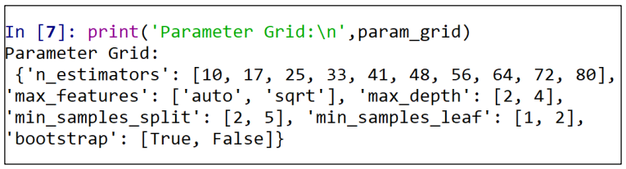
HYPERPARAMETER TUNING
Tuning of Hyperparameters refers to the process of optimizing the hyperparameters of the machine learning model.
Tuning is performed so that our model may generalize well to unseen data i.e. reduce the problem of overfitting. It also significantly improves the performance of the model
Hyperparameter tuning is a very crucial but computationally intensive process.
Here are the hyperparameters on which we have performed tuning:
n_estimators=5 numbers in the range [100,500]
max_features=['auto', 'sqrt']
min_samples_split=[2,5]
min_samples_leaf=[1,2]
Fig : Hyper Parameter Grid

Slide 35
COMMAND EXECUTION MODULE
The command execution module has three command : Wikipedia Information module , Youtube video module and Weather information module.
Wikipedia information module ( wikipedia_info()):
It fetches a summary of a given word from Wikipedia and reads it aloud using text-to-speech. Here's the breakdown
Setting Wikipedia language: Sets the language of the Wikipedia module to English.
Fetching Wikipedia Summary: Retrieves a summary of the formed_word from Wikipedia, limited to two sentences.
Text-to-Speech (TTS) Engine Initialization: Initializes a text-to-speech (TTS) engine using the pyttsx3 library
Reading Aloud the Summary:: : Instructs the TTS engine to read aloud the summary fetched from Wikipedia.

Slide 36
2. Youtube video module (youtube_video(formed_word)):
It searches for a YouTube video related to a given formed_word and plays it in a web browser.
Searching for YouTube Video: uses the YoutubeSearch library to search for YouTube videos related to the formed_word. It limits the search to one result (max_results=1) and stores the results in the results variable.
Checking if Results Exist: Checks if the results list is not empty, meaning at least one video was found.
Creating Video URL: Constructs the URL of the first video in the search results. It appends the video's URL suffix to the base YouTube URL.
Opening Video in Web Browser: Opens the constructed video_url in the default web browser, effectively playing the YouTube video.

Slide 37
3.Weather information module()read_weather()) :
It fetches the current weather information for a specific location (in this case, Kolkata) from a weather website. It then reads the weather information aloud using text-to-speech (TTS). .
Fetching Weather Information: It fetches the weather information from the given url using webscraping.
Text-to-Speech (TTS) Engine Initialization: Initializes a text-to-speech (TTS) engine using the pyttsx3 library.
Reading Aloud the Weather Information: This line constructs a sentence with the fetched weather_info and instructs the TTS engine to read it aloud.

Slide 38
LIMITATIONS
Dependency on Webcam Quality:- The model's performance is directly impacted by the quality of the webcam used. A higher resolution webcam provides clearer images, leading to better hand gesture
detection and prediction.
Sensitivity to Lighting Conditions:- The model's accuracy is influenced by the lighting conditions in the user's
environment. Adequate lighting is essential for clear image capture and accurate
gesture recognition.
Limited to Basic Alphabet Gestures:-The current model is designed to recognize and interpret basic alphabet gestures from American Sign Language (ASL). It may not accurately detect more complex
signs.
System Intensiveness:-The model's computational requirements demand a system with sufficient
processing power and memory. It is recommended to have at least an Intel i5 CPU
and 8GB of RAM for smooth operation.

Slide 39
FUTURE SCOPE
Current smart speakers and virtual assistants on the market, are not designed to cater to the needs of mute individuals. Our product bridges this gap by bringing the capabilities of virtual assistants to a segment of the population that often gets overlooked in mainstream tech development.
Real-time Translation- The virtual assistant would offer real-time translation services, converting sign language into spoken or written language and vice versa. This will be particularly beneficial in diverse linguistic environments.
Assistance in Daily Activities- The virtual assistant can assist with daily tasks based on sign language commands, providing a hands-free way for individuals to control smart home devices, set reminders, make calls, send messages, or perform other activities.
Accessibility in Public Spaces- Implementing the virtual assistant in public spaces, such as transportation hubs, offices, and hospitals, could enhance accessibility for mute individuals who use sign language.
Inclusion in Virtual Meetings- The virtual assistant can be integrated into virtual meeting platforms, enabling mute individuals who use sign language to participate in online discussions and collaborate effectively.

Slide 40
REFFERENCES
1. (n.d.). Retrieved from MediaPipe Hands Documentation: https://mediapipe.readthedocs.io/en/latest/solutions/hands.html
2. Baidaa M Alsafy, Z. M. (2020). Multiclass Classification Methods A Review. University of Thi_Qar, Thi_Qar, Iraq.
3. Latha, B. e. (2023). Hand Gesture and Voice Assistants. E3S Web of Conferences. Vol. 399. EDP Sciences.
4. Pedregosa, F. a. (2011). Scikit-learn: Machine Learning in Python.
5. Pickling: Python Object Serialization. (n.d.). Retrieved from Python Documentation: https://docs.python.org/3/library/pickle.html 6. Qi, J. (2024). Computer vision-based hand gesture recognition for human-robot interaction: a review. Complex & Intelligent Systems 10.1.
7. sklearn.model_selection.GridSearchCV. (n.d.). Retrieved from scikit-learn.org: https://scikitlearn.org/stable/modules/generated/sklearn.model_selection.GridSearchCV.html
8. Someshwar, D. (2020). Implementation of virtual assistant with sign language using deep learning and TensorFlow. Second international conference on inventive research in computing applications (ICIRCA). IEEE.
9. T. J. Swamy, M. N. (2022). Voice and Gesture based Virtual Desktop Assistant for Physically Challenged People. Tirunelveli, India: 6th International Conference on Trends in Electronics and Informatics (ICOEI).
10. Tomasz Grzejszczak, M. K. (2016). Hand landmarks detection and localization in color images. Silesian University of Technology: Multimedia Tools and Applications.
11. What is Hyperparameter Tuning? (n.d.). Retrieved from Amazon AWS: https://aws.amazon.com/what-is/hyperparameter-tuning/

Slide 41

THANK YOU
ANY QUESTIONS ?

